Slide 1
KNOW-LLEGE
Educational environment,
that teaches, not educates

Slide 2
Problem
Lack of personalized feedback
which reduces student engagement
into the educational process
Course not adapting
according to the changing interests of the user
Less than 50% of students of educational platforms graduate
The traditional education methodology used in offline learning does not work in online format
Without gamification
and maximum involvement, the level of listener motivation drops

Slide 3
Solution
KNOW-LLEGE
An educational platform that allows the user
unleash their potential by choosing an individual training track
from teachers-practitioners from the digital and creative industries
Individual learning environment
Netflix
for education
Training from industry leaders
Interactive learning map
with the possibility of opening new courses and lectures as levels in the game
A convenient format of a single subscription to everything with access not to one course, but to all educational materials on the platform
100% of the teaching staff are practitioners who share expertise and real insights from specialized industries
The format and speed of content delivery are adapted depending on
feedback and user success
Native interface for total immersion in the learning process

Slide 4
Golden circle
Why
How
What
To enable everyone to find an ideal profession and acquire the necessary skills and competencies for it
Thanks to a flexible approach to choosing an educational trajectory, a comfortable learning environment
and first-class content from educators-practitioners
An educational platform with a focus on the intuitive passage of all stages of immersion in the profession -
from career guidance
before career start

Slide 5
Market analysis
1
The quality of education and work on the return of students is the main growth driver for market players (RBC)
TAM
(all Russian EdTech market)
₽73 billion
SAM
(market of Digital professions and IT)
₽8 billion
2
Between 2019 and 2021, the value of
CAGR was 101.85% (Smart Ranking)
SOM
(the market that the company will be able to occupy, taking into account its resources, strategies for the next 5 years)
ХХХ*
3
In 2021, the target segment of the project, Digital Professions and IT, showed
90% growth (Smart Ranking)

Slide 6
Relevance
The consequences of COVID-19 laid the foundation for the shift of the educational industry in favor of digital solutions
The main trend of 2022 is the personification of material and tasks and the construction of learning experience
The first quarter of 2022 was characterized by changes in the market that caused an explosive growth in demand for young IT professionals
and digital solutions
Employers value real experience, skills, including flexibility

Slide 7
Value proposition
Young
and independent
14-18 years old
Value
Moscow, Minsk, Yerevan, Tashkent and other major cities of the CIS
Career guidance and acquaintance
with different professions in a convenient format
business and IT
Personal track adjusting
according to the user's goals
find a job you like
and become independent
Preparing a student for work
immediately after completion of training
favorable ratio of the cost of training and the result
Convenient subscription payment format
with access to all educational materials
On a way
to success
17-24 years old
Value
Moscow, Minsk, Yerevan, Tashkent and other major cities of the CIS
An educational track that changes
at the request of the user
business and IT
earn more, change the current
place of work, improve your
competitive attractiveness
Ability to customize duration
course allows you to quickly acquire the necessary
knowledge in the profession and start earning
proposed course program
and quality of presentation
Smooth immersion in new professions
for a painless profile change

Slide 8
Product presentation
Selection of a track that will be of interest to the user
The user undergoes free psychometric testing, which evaluates personal qualities, as well as generates data for career guidance and offers the best track
Responsive Content
and learning format
Choice of specialization
within the course
The educational process is designed in such a way that, depending on the reaction and success of the user, the content can be presented in various formats: lecture, text + images, interactive boards, and so on. As they progress, the user will be offered additional branches of related disciplines and soft skills
The user enters the platform, where a large mind map is available to him
First, several points-lessons are opened, passing through which others become available to the user.
Depending on the goals, the user will be given recommendations,
what trajectory to follow:
something optional, something required
aha moment

Slide 9
Non-linear learning track
Analysis of the information online:
20 %
Project manager
Creative Producer
Identification of audience requests and trends
Master class from a star of production
Production stages
64%
0%
Producing
Producer: Level 1
Producer: level 2
Executive producer
Test
Test
Hierarchy of the film crew, working out cases
What to do with an idea, bringing it to a pitch
Content manager
***
producer
Communications: Base 40%

Slide 10
Competitive advantage matrix
Know-llege
Progressive approach to determining the educational trajectory
Flexible learning system
Share of teachers-practitioners
60%
40-50%
70%
30%
30%
50%
80%
100%
Payment type
per course
Subscription
Access to courses
Only to purchased
To all
Focus on getting a promotion, going to work
Источник: Smart Ranking

Slide 11
Business model
Визуализация opex / capex и основные выводы из нее сможем сделать после просмотра таблицы Пример таблицы: https://docs.google.com/spreadsheets/d/1RDetwqYSdV2VeHkLCg7jgZmqbB2wJZiu/edit?usp=sharing&ouid=103771313573285125537&rtpof=true&sd=true
Подписочная модель
2000-4000 руб / мес

Slide 12
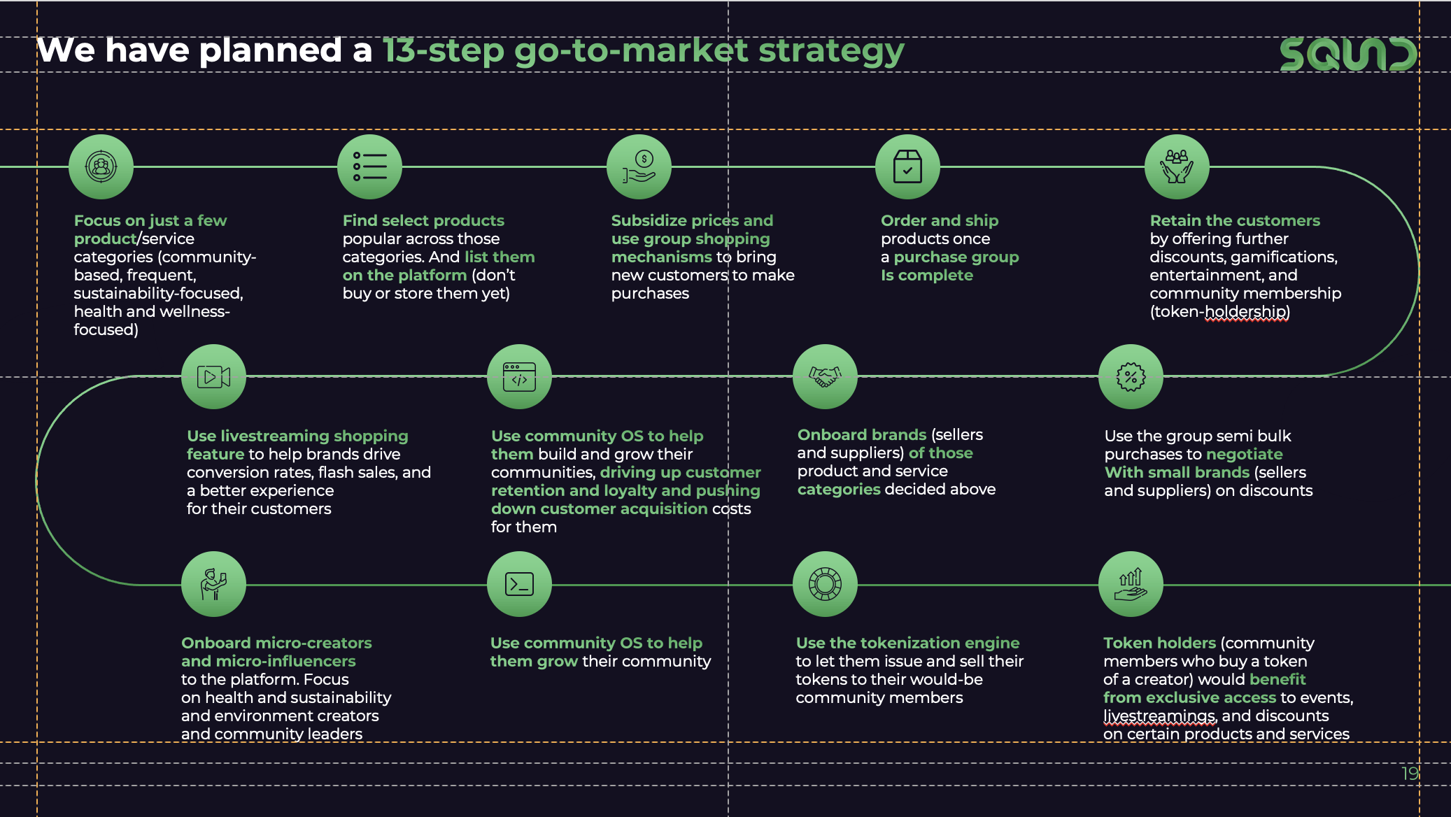
Go-to-Market Strategy
В классическом виде слайд GTM стратегии обычно подразумевает описание ключевых шагов в маркетинговой / sales стратегии:
Определение фокусной аудитории для первого запуска
Определение продуктов, которые будут продвигаться в первую очередь
Определение каналов, в рамках которых будет производиться таргет на эту ЦА
Определение способов продвижения
Какие метрики будут использоваться для оценки эффективности маркетинговой стратегии
Какие будут дальнейшие шаги для удержания приобретенной аудитории
Этапы запуска кампаний (других продуктов / на новые ЦА)
Notes:
Увеличение рынка в связи с расширением сегментов ЦА

Slide 13
Team
Ждем информацию по команде

Slide 14
Strategic Roadmap
Wave 1
Wave 2
Wave 3
MVP
Core product
Full-scale product
1
Testing the Effectiveness of a Psychometric Test
as a standalone product
5
Development of the full cycle of the product on a mass user
8
Development of educational programs at the undergraduate level for mid-level specialists
2
MVP launch
educational platform:
- Personal Area
- Interactive user map
- Adaptive Interfaces
9
Application of ML-models to analyze student behavior in order to more accurately personalize educational content
6
Assessment of user knowledge with the possibility of obtaining an electronic certificate
3
Launch of 3 own study areas
7
Expansion of own courses in 5-10 directions
10
Development and implementation of B2B solutions, R&D to provide additional value to users and partners
4
50-100 career profiles with recommended online courses
11
Transformation of the platform into an educational ecosystem

Slide 15
Investments needed
Round Goals
50%
payroll fund
MVP development and testing
10M ₽
25%
Program testing
on 2-3 educational tracks
Content production
25%
Running a psychometric test
Research and advertising

Slide 16
We'll be happy to tell you more about our project!

